Slide 1
SC1015 Mini Project
Team 5
Jiang Li Kai, Heng Zeng Xi ,
Ang Wei Ming

Slide 2
TABLE OF CONTENTS
03
01
02
04
INTRODUCTION
CORE ANALYSIS
Main Machine Learning Techniques
Solving The Problem
Dataset Used
Motivation
OUTCOME
EXPLORATORY DATA ANALYSIS
Interesting outcome
Views towards the target problem
Initial data-driven Insights
Data-Cleaning

Slide 3
01
INTRODUCTION

Slide 4
DATASET & PROBLEM DEFINITION
Heart disease dataset from the UCI Machine Learning Library https://archive.ics.uci.edu/ml/datasets/Heart+Disease
Our primary goal is to develop a machine-learning model capable of predicting the presence of heart disease in patients based on various medical and demographic features

Slide 5
MOTIVATION
01
02
18 Million Deaths
Improve Healthcare System
Cardiovascular diseases, including heart disease, account for approximately 18 million deaths globally each year, early detection is crucial for effective intervention.
To leverage on machine learning models to identify high-risk individuals and implement targeted prevention and treatment strategies, reducing the overall burden of heart disease on healthcare systems

Slide 6
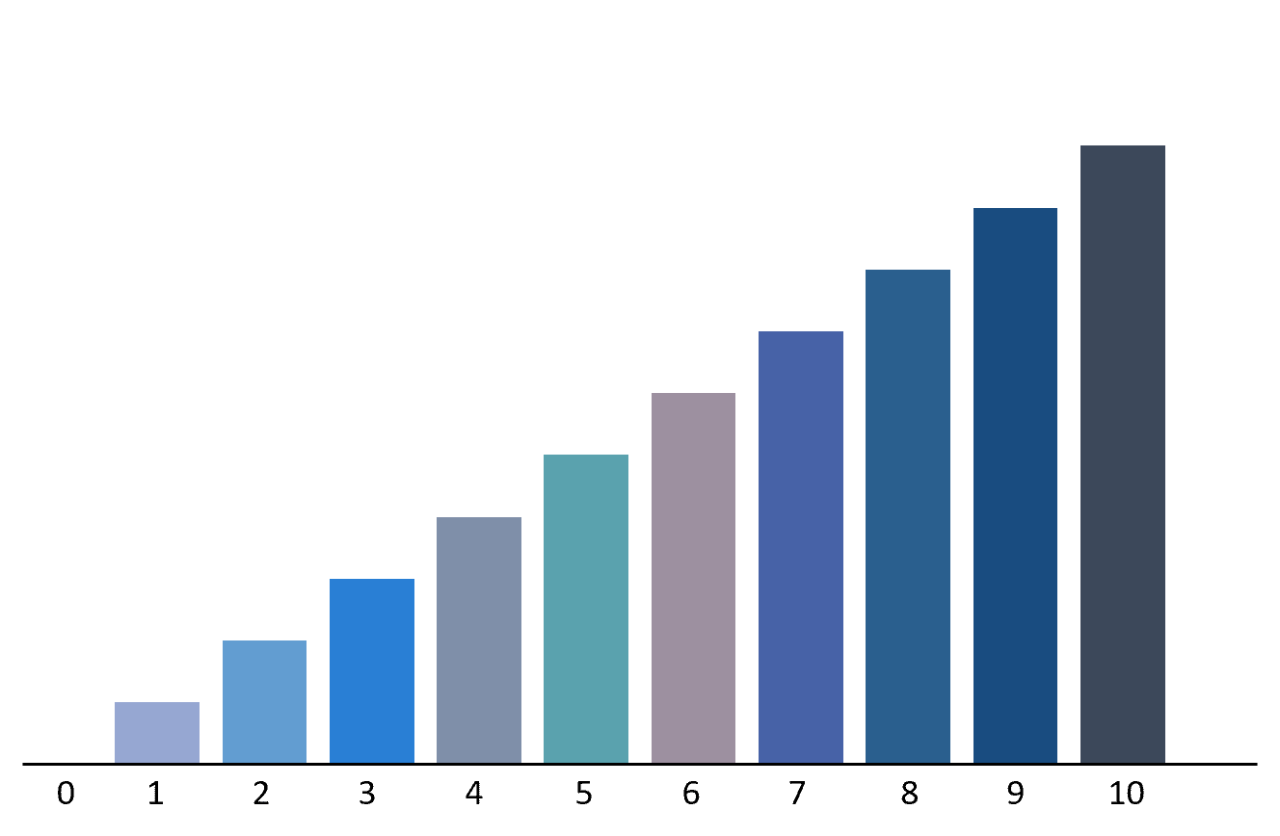
02
EXPLORATORY DATA ANALYSIS &
DATA CLEANING

Slide 7
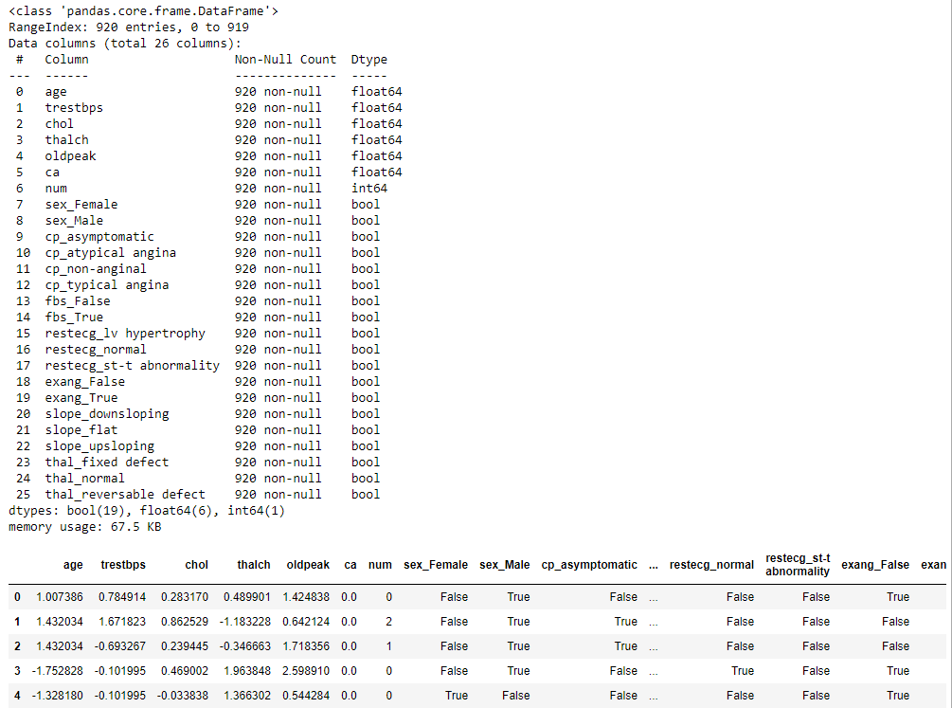
Data Cleaning & Preparation

Slide 8
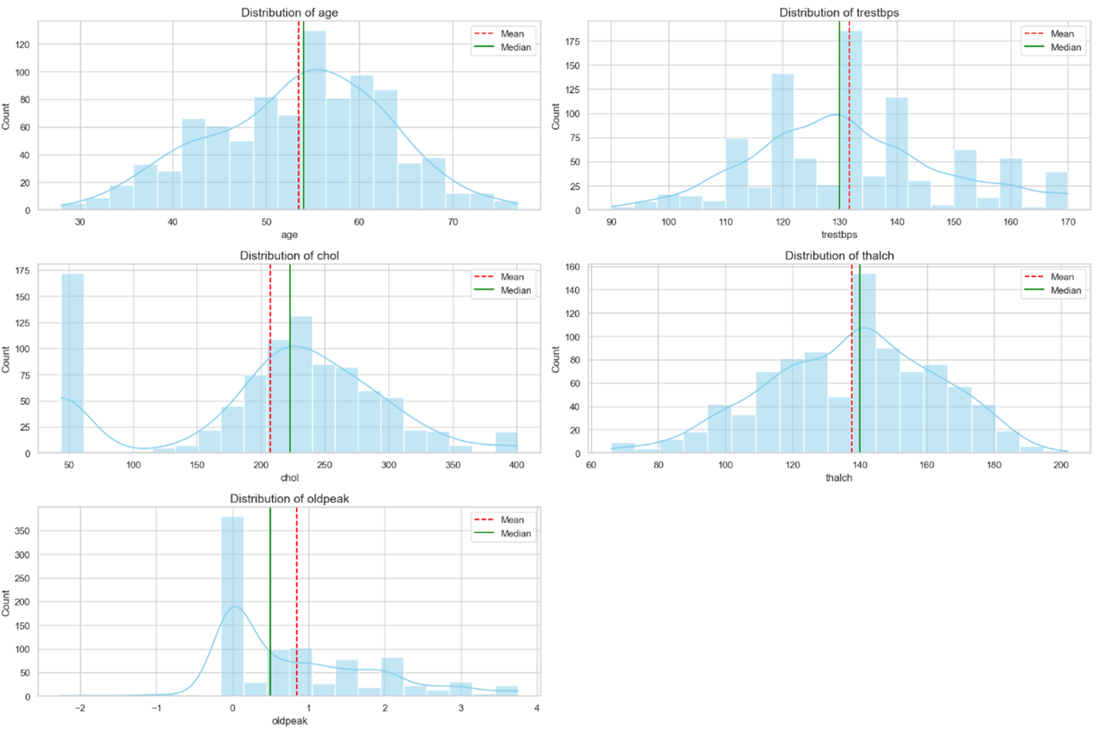
Histogram

Slide 9
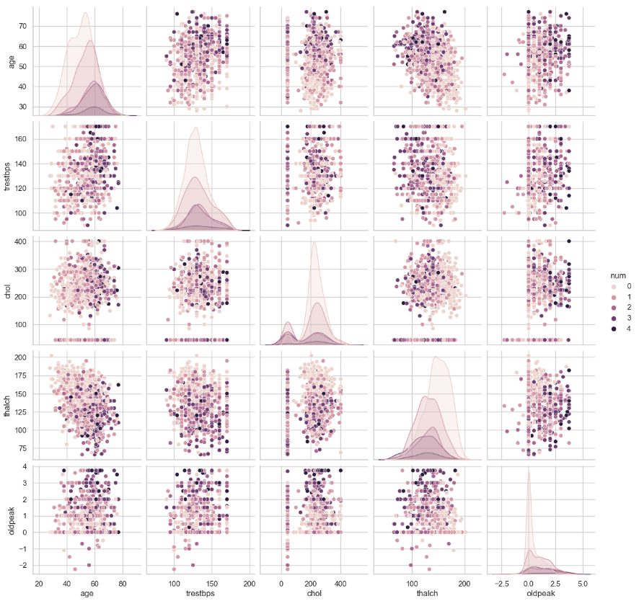
Scatter Plot Matrix

Slide 10
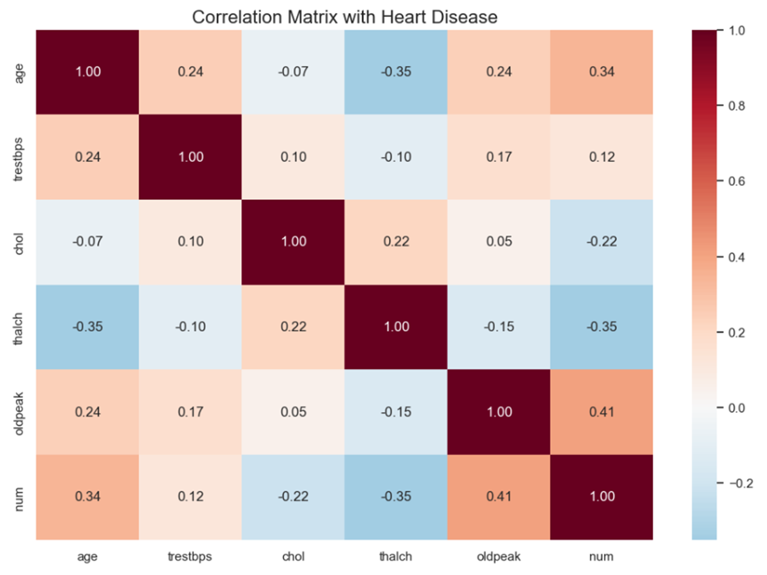
Correlation Matrix

Slide 11
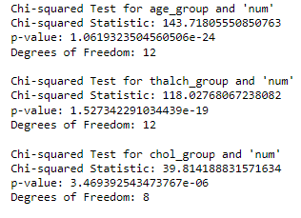
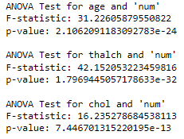
Chi-Squared and ANOVA Test

Slide 12

03
CORE ANALYSIS

Slide 13
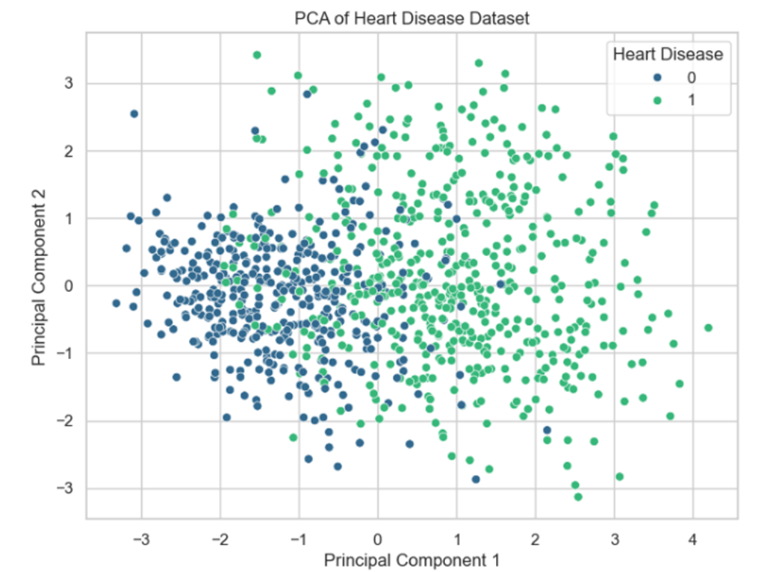
Principal Component
Analysis

Slide 14
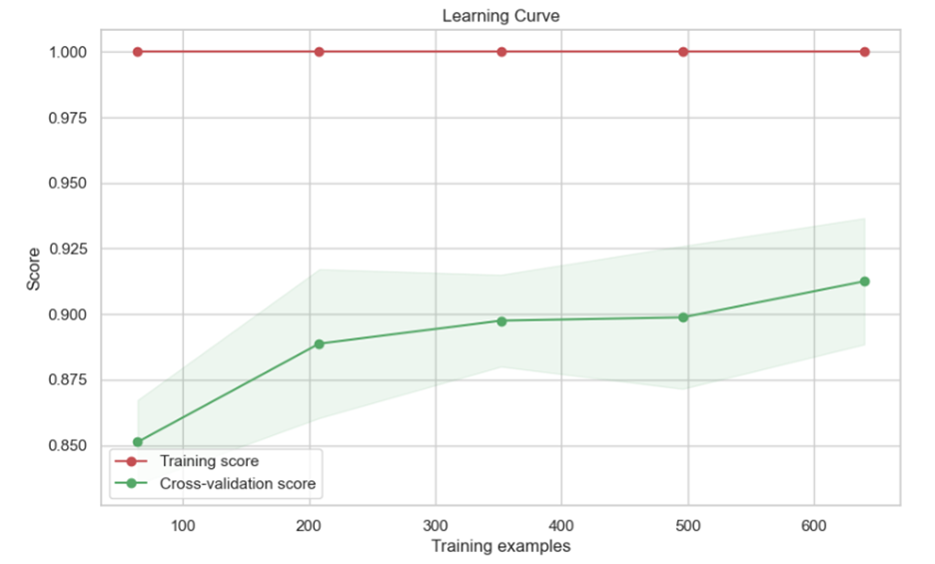
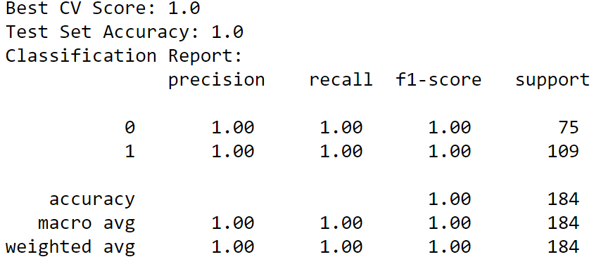
Random Forest
Classifier
Learning Curve

Slide 15
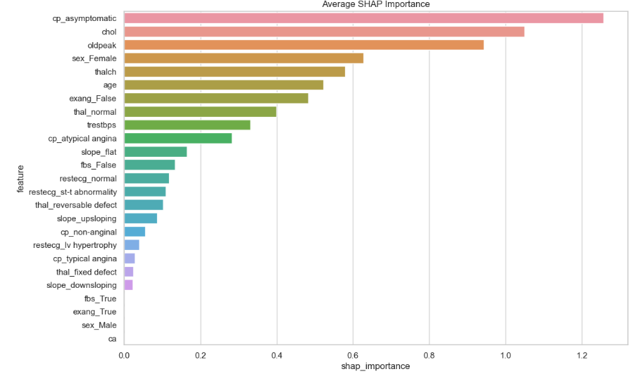
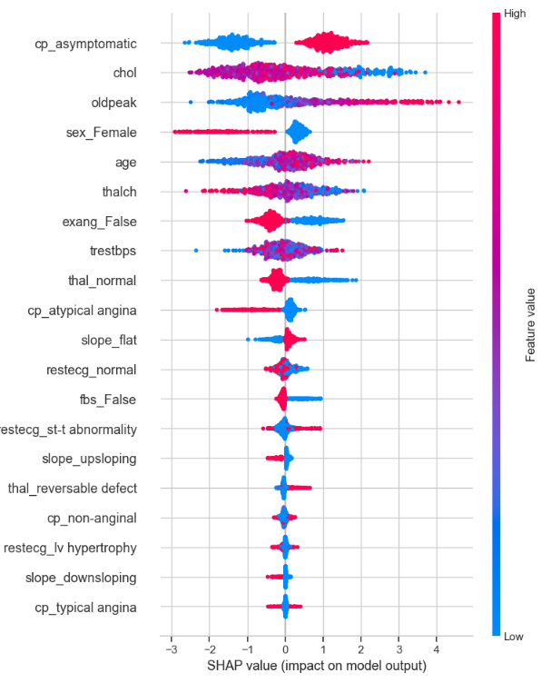
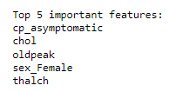
SHAP Values & Distribution

Slide 16
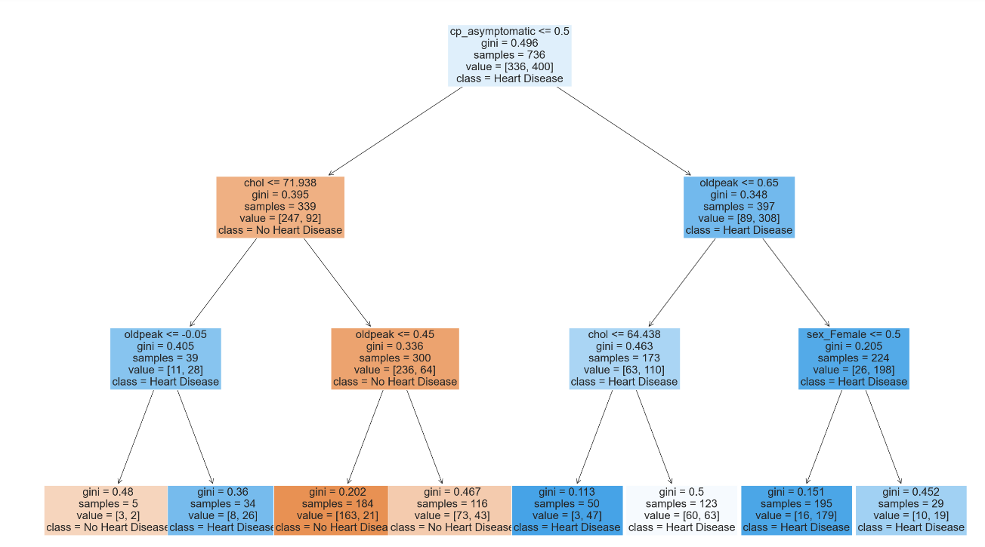
Decision Tree

Slide 17

04
OUTCOMES & FINDINGS

Slide 18
Outcomes & Interesting Findings
We successfully developed a machine-learning model capable of accurately predicting the presence of heart disease based on various medical and demographic features. This achievement directly addresses our original problem statement, providing a valuable tool for early detection and intervention in heart disease cases.
Our analysis unearthed groundbreaking discoveries that revolutionize our comprehension of heart disease risk factors. Among these revelations are previously underestimated elements like asymptomatic chest pain and gender-specific distinctions, illuminating profound dimensions of heart disease diagnosis and treatment.

Slide 19
Data-Driven Insights
Highlight the importance of considering a comprehensive set of factors in heart disease prediction and management.
By leveraging machine learning techniques, we uncovered key predictors such as asymptomatic chest pain, cholesterol levels, and gender differences, which were previously underappreciated in traditional risk assessment models.

Slide 20
THANK YOU!

